Slide 1
Kickstarter Projects
Business Intelligence - II
Nigar Salmanzade
30 September 2023

Slide 2
Contents
Introduction
Business Understanding
Data Understanding
Data Preprocessing
Modelling
Model Evaluation and Fine-tuning
Conclusion
References

Slide 3
Introduction
Kickstarter Projects
The most popular website for crowdfunding projects
Raising a total of $3,430,261,148
326,133 of those projects have been financed
Success rate of 35 percent.
We analyse the Kickstarter project data from 2018
Methodology; CRISP - DM

Slide 4
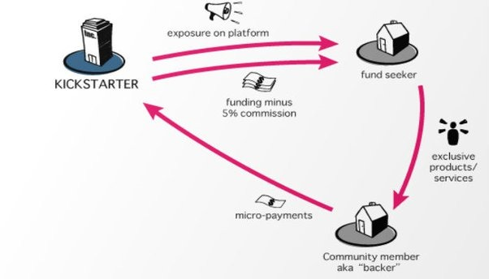
Business Understanding
Interesting questions
Which category of projects are more likely to be successful?
Does Date, Month, Quarter, Weekday make an impact on project funding?
What is the Average funding required for different categories of successful projects?
Success rate of different categories in different countries?
Money Matters?
Main Hypothesis
Predicting if a project is successful or a failure.

Slide 5
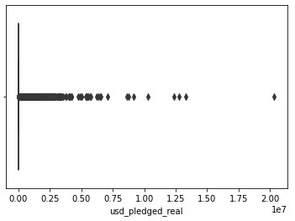
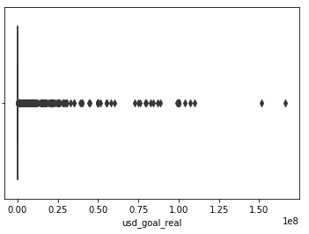
Data Understanding
The dates of the project range from April 21st , 2009 to January - 2nd, 2018
The Data has 15 variables and 378,661 rows of values.
Higher number of categorical and symbolic variables.
Verifying Data Quality
Missing Values
The variable name contains four missing values and the variable usd pledged contains 3797 missing values.
Outliers
The number of outliers for usd_pledged_real and usd_goal_real are 50,578 and 45,508 respectively.
Data Integrity
In this dataset we have country values called N,0" which is inconsistent

Slide 6
Exploratory Data Analysis

Slide 7
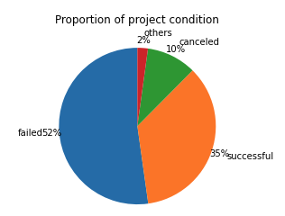
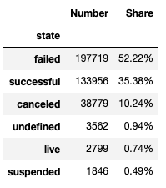
State of the Project

Slide 8
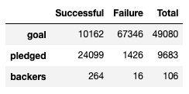
Money Estimates
Average values for Funding goal, Amount pledged and Number of backers
Average contribution by a backer is $ 76.
Highest backed and Least backed Product.
Pebble Time Smartwatch was the highest backed product with the amount raised being 20,338,986 USD. Their goal was 500,000 USD.
Allenby leather bags was the least backed product. An individual who backed them has invested 1.01 USD and their goal was 10,066 USD. This product is the least backed among campaigns where the goal was greater than 1 USD.

Slide 9
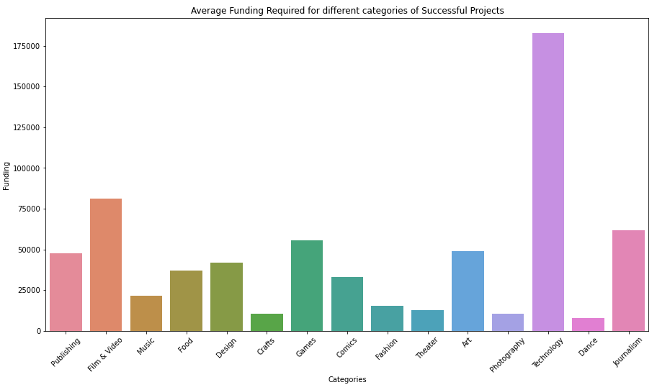
Money Estimates
Average Funding required different categories of successful projects.
The average goal for successful technological projects is 182,840 USD.

Slide 10
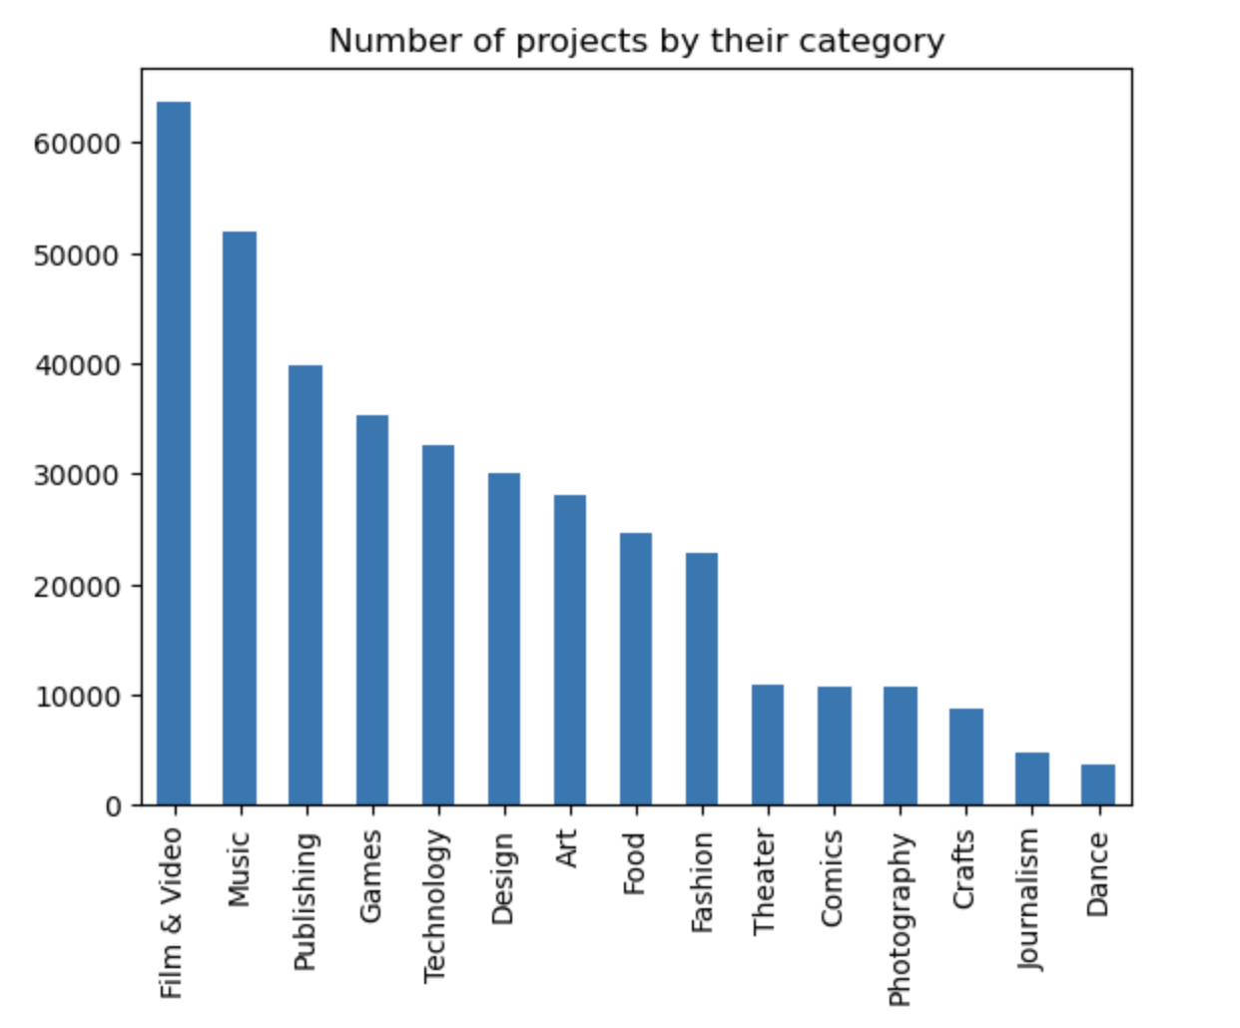
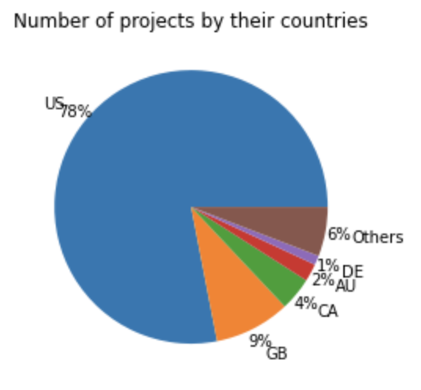
Country and Project category evaluation
America accounts for 78 percent of the projects followed by Great Britain and Canada.
Film & Video has the highest share of the projects at 16.79 percent and 63,585 projects. Followed by Music and Publishing. It is surprising to see that Technology, Food and Fashion account only for 21 percent of the share.

Slide 11
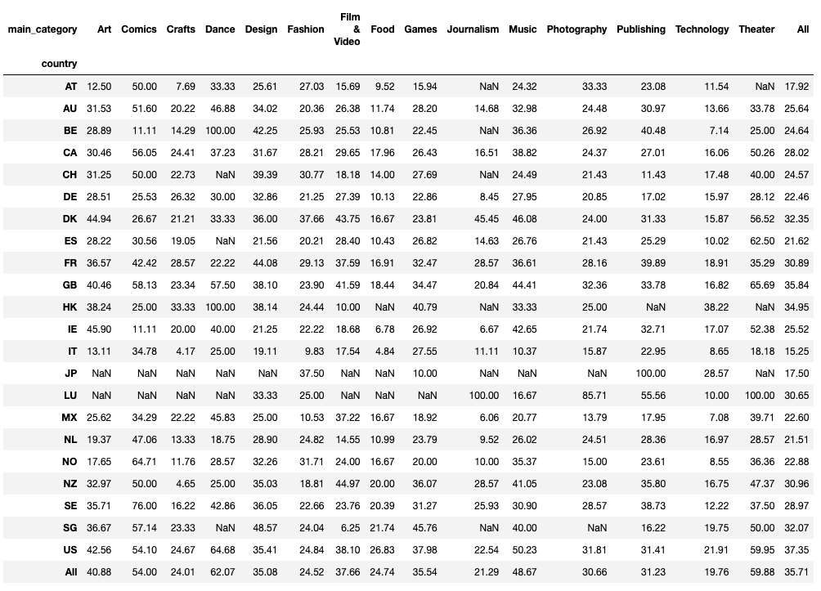
Countries and Project category exploration

Slide 12
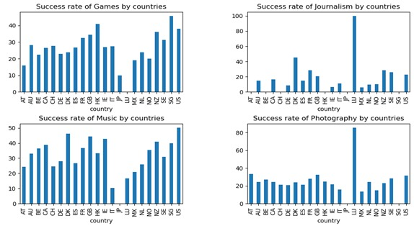
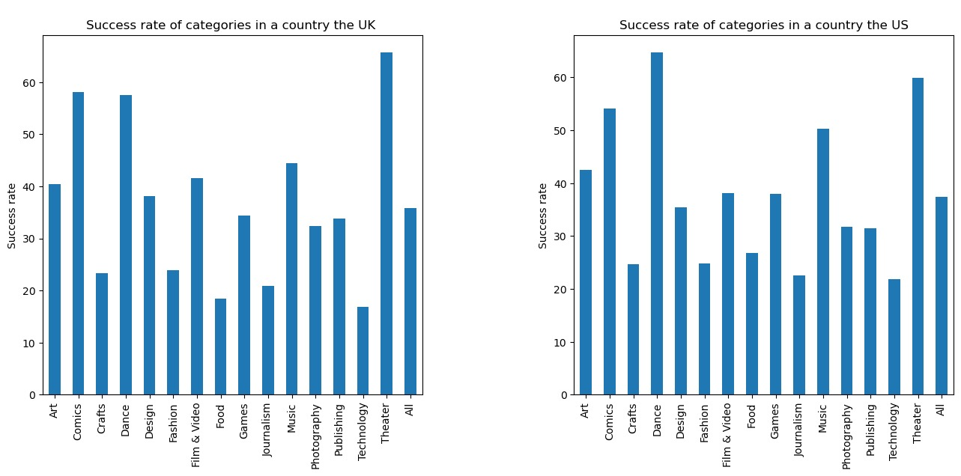
Plotting Countries and Project category Interaction

Slide 13
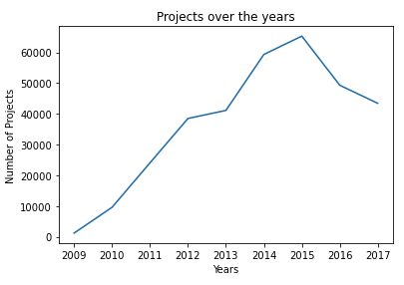
Datetime Variable Analysis
Kickstarter started in 2009 with 1179 projects. In the first year itself the number of projects grew by over 8 times to 9577. The number of projects reached a peak of 65,272 in the year 2015.

Slide 14
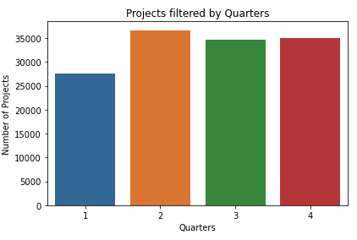
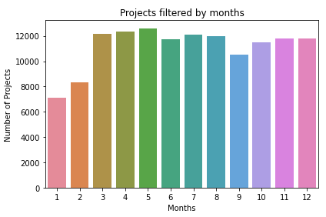
Datetime Variable Analysis
Projects facing deadline in the first quarter are more likely to fail

Slide 15
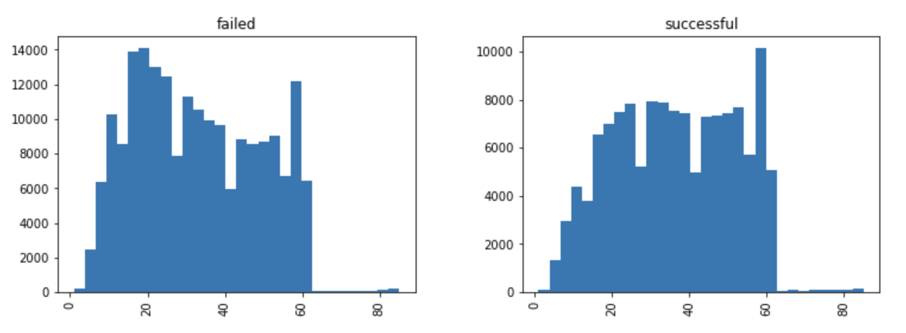
Plotting Average Word Length

Slide 16
Data Preprocessing
Numerical Variables
Dropping Unnecessary Variables
Categorical Variables
The data after being scaled and creating dummy variables has 68 variables and 331675 values. The data is then split into train and test data with the test data size being 30 percent of the original data set.

Slide 17
Variables Used for Model Prediction
Goal of the project (USD)
Number of Weekdays between launched and deadline date
Main category
Year Launched
Month Launched
Country
Launched Weekday

Slide 18
Modelling
Logistic Regression
Random Forest Classifier
Bagging
AdaBoost
Natural Language Processing

Slide 19
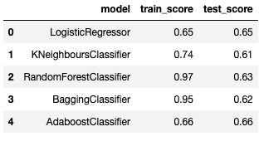
Model Evaluation
Training and Test Accuracy score.
For the NLP model we get a train score of 0.734 and a test score of 0.65

Slide 20
Fine-tuning the model.
We used Cross-Validation using a range of hyper parameters to get the best parameter values for Logistic Regression and Random Forest Classifier.
Applied Model | Best Result
Logistic Regression | C (Inverse of regularization Strength) as 100
Random Forest | Minimum Sample leaf of 5 Minimum Sample split of 6 Number of Estimators as 200 Maximum depth of 7
The accuracy has increased from 0.63 to 0.64 for Random Forest.

Slide 21
Conclusion

